Slide 1
Lecture 1
Introduction to Big Data

Slide 2
What is Big Data?
“Big Data” is data whose scale, distribution, diversity, and/or timeliness require the use of new technical architecture and analytics to enable insights that unlock new source of business value
Source: McKinsey Global Institute, Big data: The next frontier for innovation, competition, and productivity. May 2011
Is there any size threshold over which data becomes big data?
What kind of new tools, new analysis methods, etc required?

Slide 3
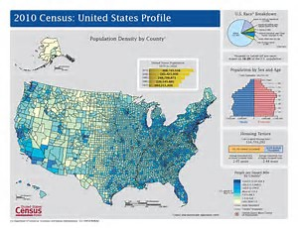
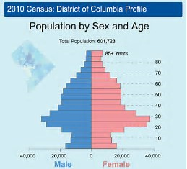
Big Data Examples
2010 US Census data
A huge gold mine of information

Slide 4
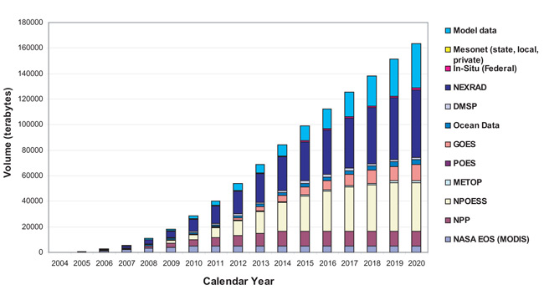
Facebook:
900 million users, 40+ billion photos, 6+ billion messages, 5­00 TB per day

Slide 5
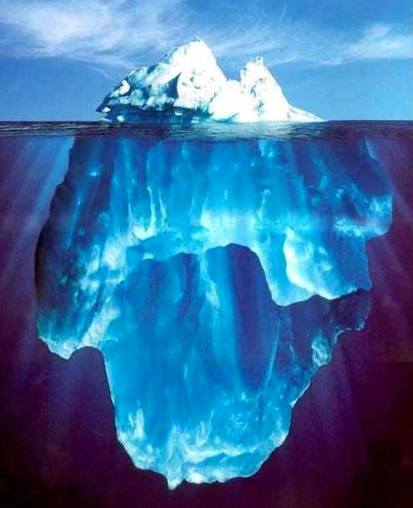





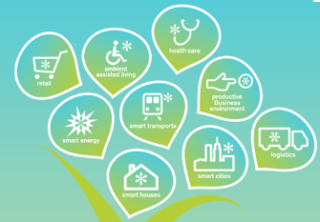
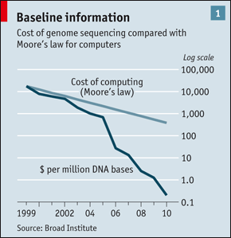
Big Data Sources
It’s All Happening On-line
User Generated
Every click of:
Ad impression
Billing event
Fast Forward, pause,…
Server request
Transaction
Network message
Fault
…
…..
Internet of Things / M2M
Health/Scientific Computing

Slide 6
Activity #1
Which of the following is/are considered as big data?
A 5MB image file
All the data collected by Mars Exploration spacecrafts
A pdf file containing a book of 500+ pages
200+ GB payroll data stored in a SQL database

Slide 7
“Working” Definitions of Big Data
A data set that is too large for you to process efficiently in the memory of a single machine, and therefore must be distributed across a cluster. (Mark Lewis, Trinity University)
Data sets that are too large or complex to be dealt with by traditional data-processing application software. (Wikipedia)
Your definition?

Slide 8
What makes data, “big data”?
Organization are driving business benefit from analyzing ever larger and more complex data sets that increasingly require real-time or near-real time capabilities
Example
Google collects 270PB data in a month (2007), 20PB a day (2008) …

Slide 9
Activity #2
Notes: (1) all units used in this class refer to base-2 notation, i.e. PB here refers to PiB.
(2) may work with a study partner or in a small group of 2-4.
1. How large is 1PB?
1 PB (petabyte) = ? TB = ?? GB
2. For a hard drive of 5 TB (i.e. 5 TiB), how many bytes exactly it has?
3. For a cable with speed of 128Mbps, if we’d download a video of 6GiB, ignoring any other overhead, how many seconds needed? How long it takes to download a video of 6TiB? 6PiB?
4. Which units are larger than PB/PiB?

Slide 10
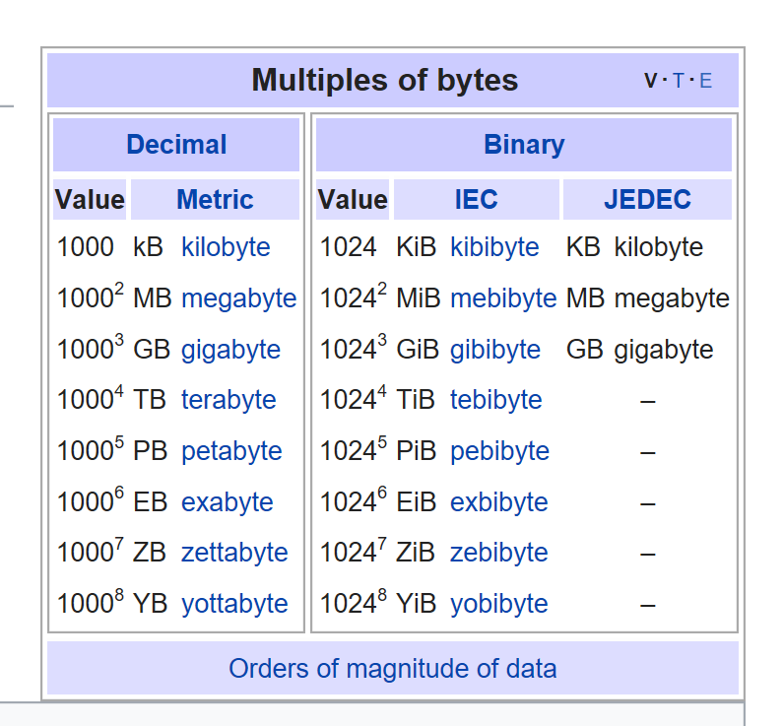
Quantities of Bytes Source: https://en.wikipedia.org/wiki/Template:Quantities_of_bytes

Slide 11
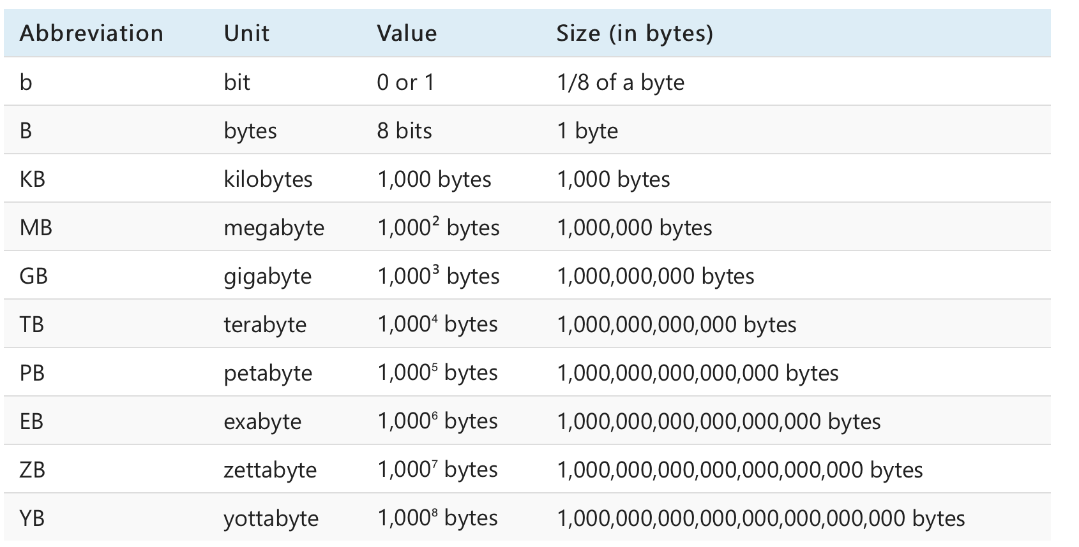

Slide 12
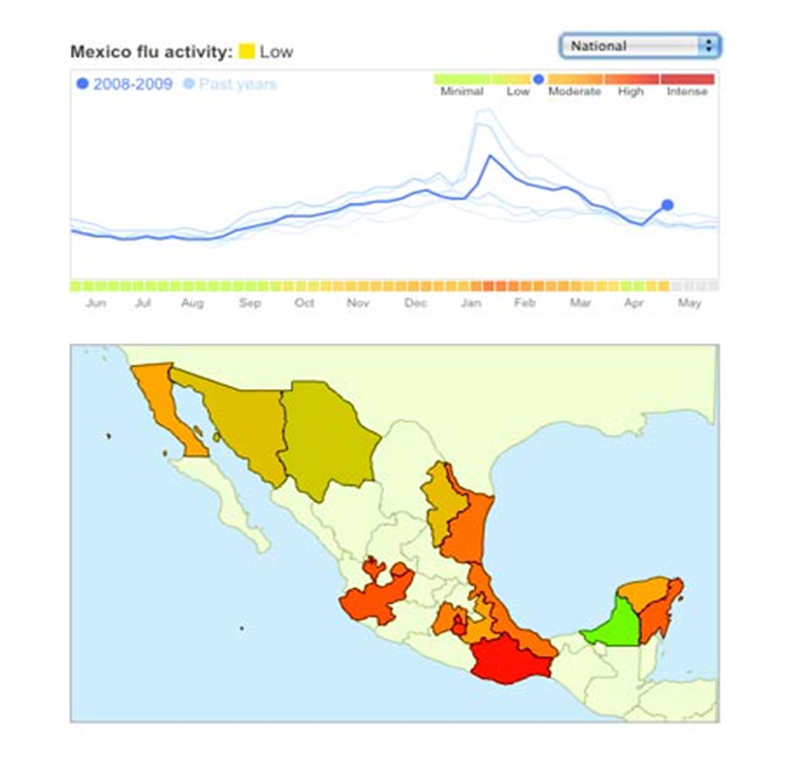
Big Data: Why all the Excitement?
Exciting new effective applications of data analytics
e.g. Google/Twitter Flu Trends:
Detecting outbreaks two weeks ahead of CDC data by summarizing flu-related keywords from online searches/posts
New models are estimating which cities are most at risk for spread of the Ebola virus.
Prediction model is built on various data sources, types and analysis.

Slide 13
Twitter/Google flu trend (story behind)
During the flu season, doctors are required to report to CDC (the center for disease control) how many patients they saw had caught flu
Doctors usually report weekly
CDC summarizes the data and give public reports
The information on reports usually 2 weeks old
When people had flu symptom, they usually search on google how to treat certain flu symptoms or post their symptoms on twitter
Google/twitter collects online keywords and summarizes instantly (the area with high frequency of these keywords on flu symptom must have flu break there.)
https://en.wikipedia.org/wiki/Google_Flu_Trends

Slide 14
How to access some big data sets?
Yelp data set download
https://www.yelp.com/dataset/download
US Census data
https://www.census.gov/programs-surveys/decennial-census/data/datasets.2010.html
Healthcare data
http://www.archer-soft.com/en/blog/10-best-healthcare-data-sets-examples
Fitness data?
Can you find more??

Slide 15
Activity #3: group activity (group: 2-3)
Recall the Fitbit paper that you’ve read
What kind of data the author used? (use your imagination)
Can you find a way to access such data?
If yes, where did you get it?
If not, find another big data set that could be accessed freely by public
The approximate size of the data you found
Share with the class
What data set you found
Where to access
The approximate size of the data set
(optional) what can you do with the big data set?

Slide 16
Key Characteristics of Big Data
Huge Data Volume
e.g. billions of rows and billions of columns
Unable to efficiently analyze using traditional databases
44 X increase from 2010 to 2020 (1.2 zettabytes to 35.2zb)
Complexity of Data Types and Structures
Greater variety of data structures to mine and analyze
Data Growth is Increasingly Unstructured
80-90% unstructured
The 5Vs of big data (3Vs -> 4Vs ->5Vs)
Velocity, Volume, Value, Variety, and Veracity (reliability)

Slide 17
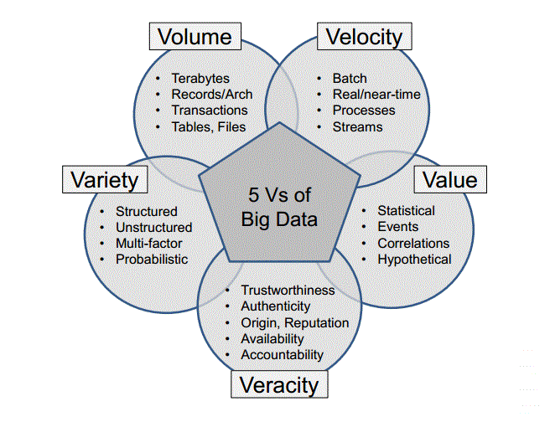
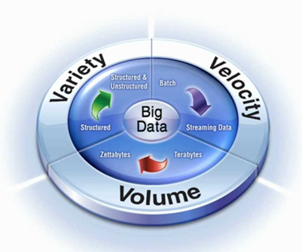
The 3 to 5 “V”s

Slide 18
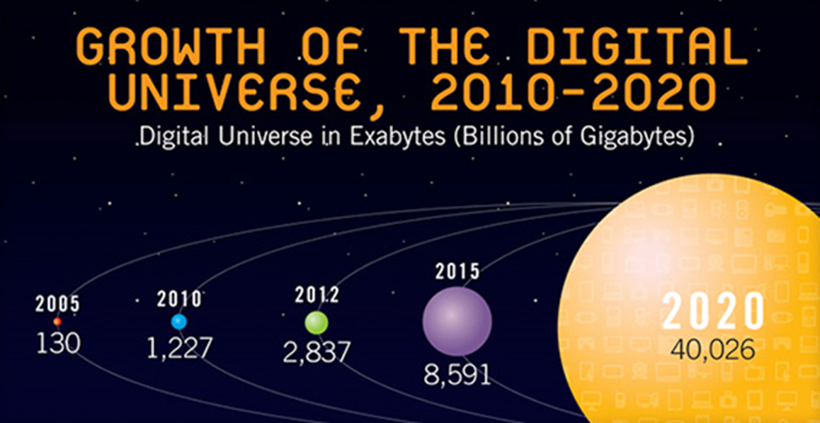
Volume and Velocity

Slide 19
Some recent data
Here are some key daily statistics highlighted in the infographic: (April 15, 2019)
500 million tweets are sent
294 billion emails are sent
4 petabytes of data are created on Facebook
4 terabytes of data are created from each connected car
65 billion messages are sent on WhatsApp
5 billion searches are made
By 2025, it’s estimated that 463 exabytes of data will be created each day globally – that’s the equivalent of 212,765,957 DVDs per day!
https://www.visualcapitalist.com/wp-content/uploads/2019/04/data-generated-each-day-full.html

Slide 20
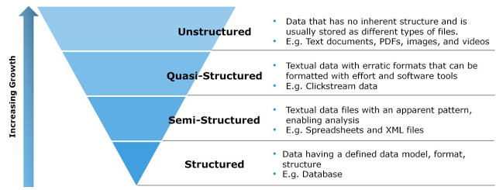
Variety

Slide 21
Value
Worth of big data
big data = money
Examples
Companies are collecting huge consumer data to decide what kind of new products to promote
People are (illegally) selling big data (e.g. hotel guests information, consume spending habits, …) for money!
Discussion:
Brainstorming and share/discuss cases that making big data valuable

Slide 22
Veracity
Can you trust the data being collected and stored?
Data is cheap to get, but what about “quality” data?
How much “junk” data now flowing around the world?

Slide 23
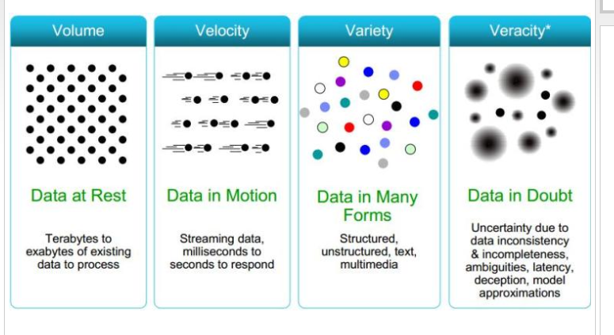
https://www.datasciencecentral.com/profiles/blogs/

Slide 24
Emerging big data opportunities
Transaction Databases
Recommender systems (Netflix), Fraud Detection (Security and Privacy), …
Wireless Sensor Data
Smart Home, Real-time Monitoring, Internet of Things, …
Text Data, Social Media Data
Wikis content aggregator, Product Review and Consumer Satisfaction (Facebook, Twitter, LinkedIn)
Online transaction processing
Online shopping, gaming, banking, …
Scientific research
Biological analysis, Space exploration, …

Slide 25
Assignment #1
Goal: Exploring the world using big data set.
Activity: Find a source that contains public accessible big data, share the following information/thoughts with the class. (Note: this is the continuation of activity #3)
Note: You cannot use the links in Lecture1-1 slides nor can you use the Kaggle.com site.
(1) Site and data set (A brief description of the site and the data set, what’s data set about, a link to the site or dataset, …)
(2) How the data is generated? (e.g. by sensor, by people, …)
(3) How data is stored? (e.g. in what format, what kind of database, …)
(4) What can we do with this data? (i.e. probing reality, pattern discovery, predicting future events, ….)
(5) How big data (using this dataset as an example) could help understanding people and the world?
Post your answer on discussion board. One post per group.
Due Date: see class announcement.

Slide 26
Summary and Comments
Unlimited opportunities with big data …
The growth of big data led to a new discipline
Data science!
Many universities have introduced or are introducing data science majors or integrate data science education into computer science programs
Example: UC Berkeley Data Science Program
https://data.berkeley.edu/education/
Cal Poly Pomona – We’re working towards this direction.
Next lecture: Characteristics of Big Data
We will take a inside, more in-depth look at big data!
End of Lecture

